Slide 1
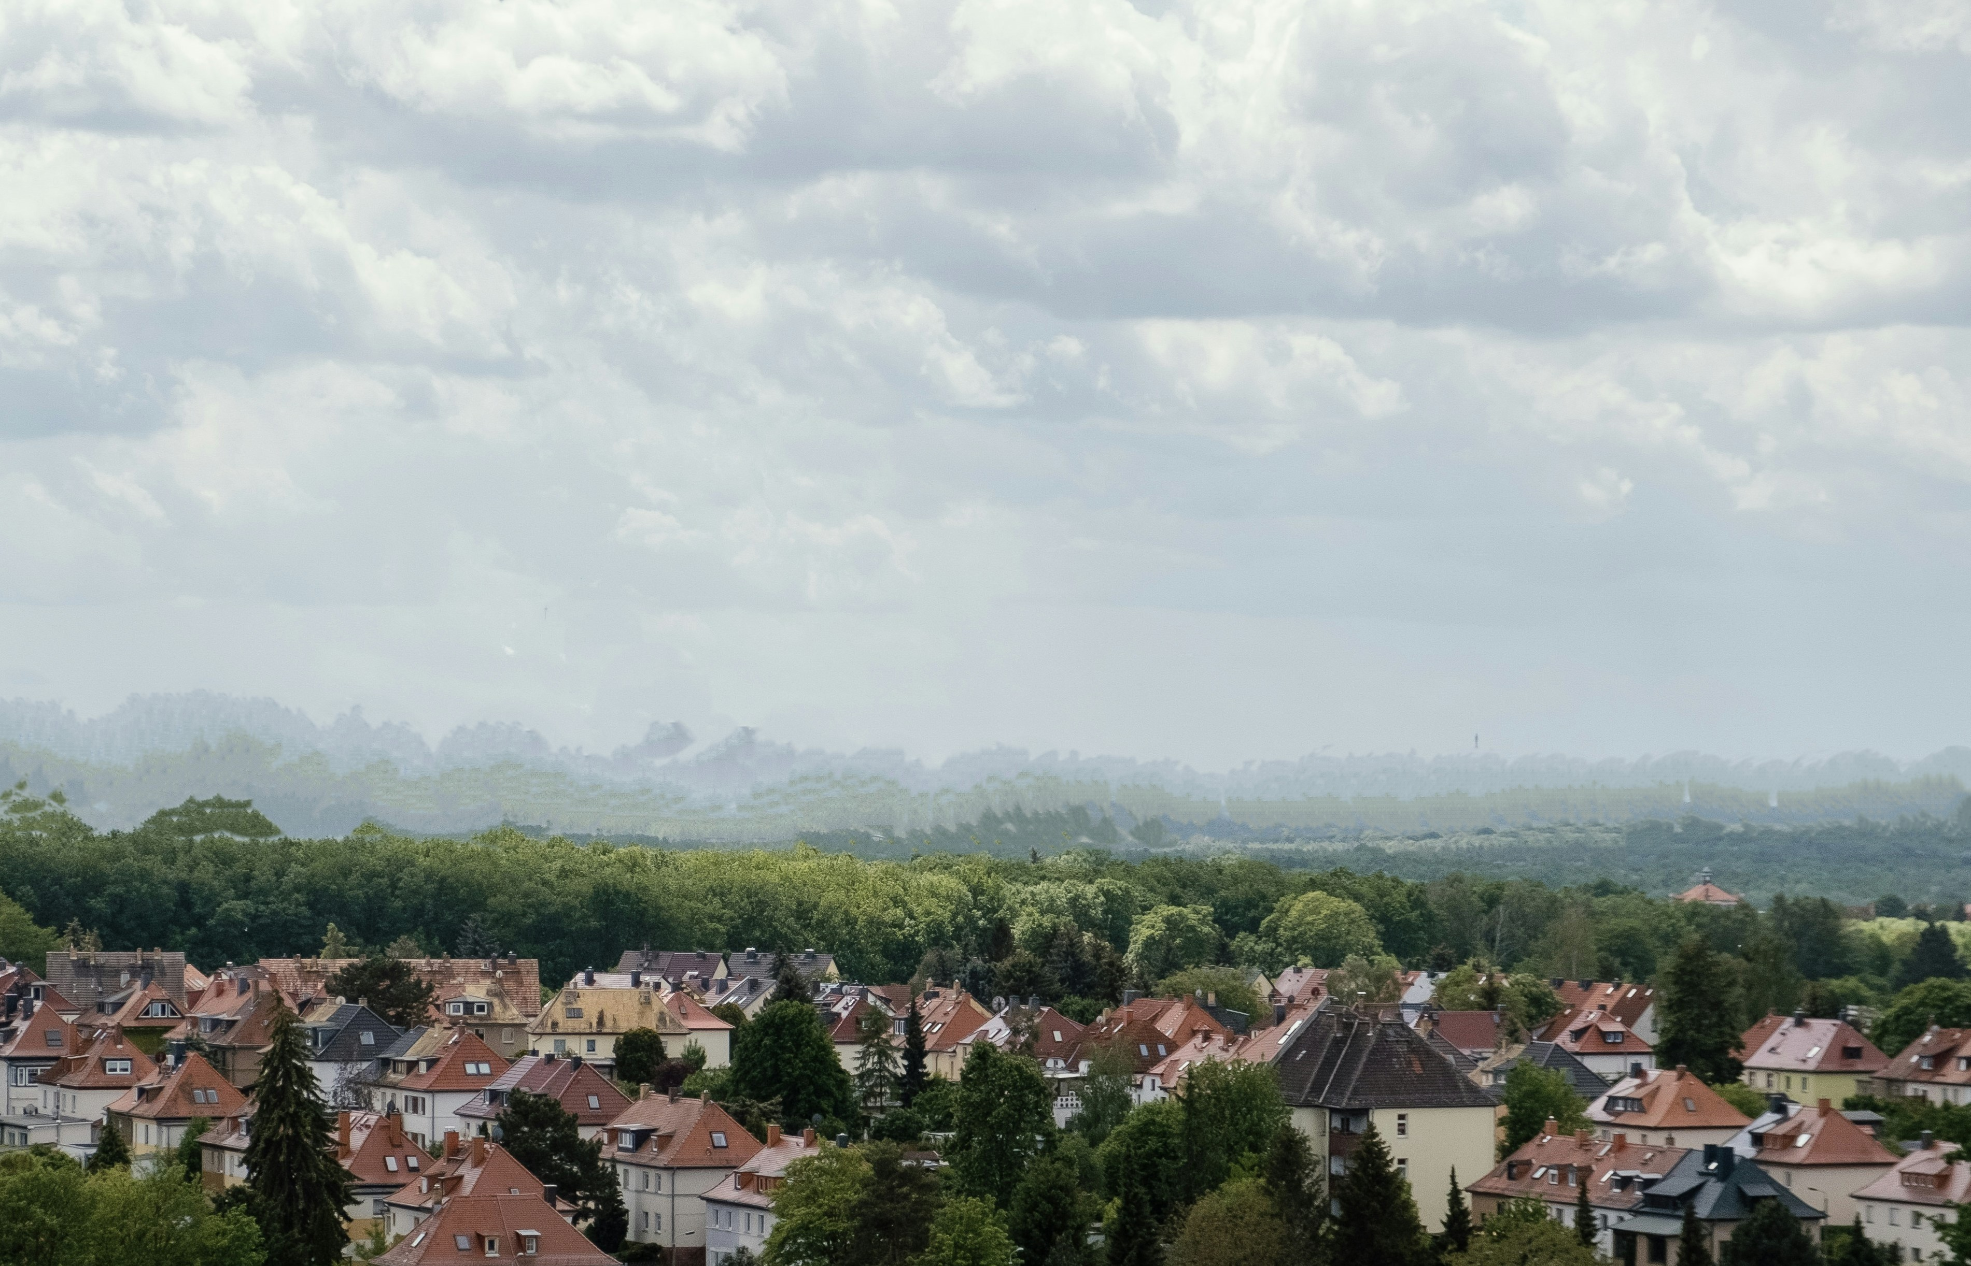
LERTECHX RENEWABLE ENERGY RAIN POWER FOR SUSTAINABILITY AND COST REDUCTION
LEONARD.EVA@LERTECHX.COM
CLEAN ENERGY GENERATION AND STORAGE
THE RAINWATER TECHNOLOGY IS ON
WHEN THE SOLAR OR WIND SYSTEM IS OFF

Slide 2
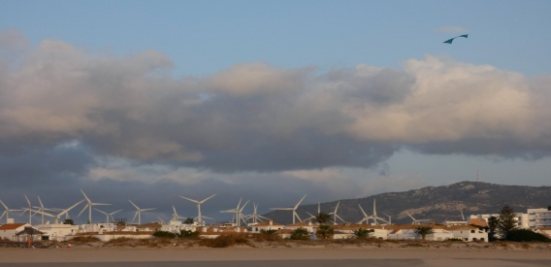
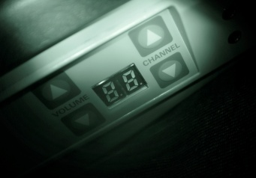
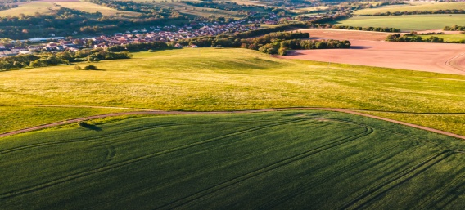
Renewables Constraints
LEONARD.EVA@LERTECHX.COM
Solar and Wind are intermittent sources of energy, not efficient (5-20%) in bad weather conditions, $2B Global Market being affected.
The batteries need replacement and the extraction of minerals has a negative environmental impact.
Land footprint for the green energy deployments is a major issue, causing 10% of the projects not to be approved.
https://www.mckinsey.com/industries/electric-power-and-natural-gas/our-insights/renewable-energy-development-in-a-net-zero-world-land-permits-and-grids
In average 1kW/57 square feet.
Weather / Power generation
Power OFF
Land availability

Slide 3
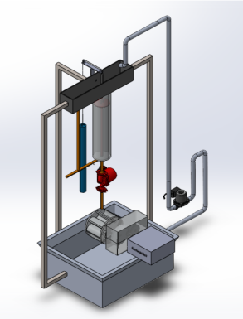
Solution
LEONARD.EVA@LERTECHX.COM
Rainwater Generator, that uses precipitation* collected on the roof to produce and store energy
Generates up to 3000 kWh/year, on rainy weather, day or night.
Includes a solar/hydro energy storage unit, as a sustainable alternative to batteries.
19 square feet footprint system installed on-site.
*Once the system is loaded it can recirculate the rainwater being able to run even on sunny days.
RWG

Slide 4
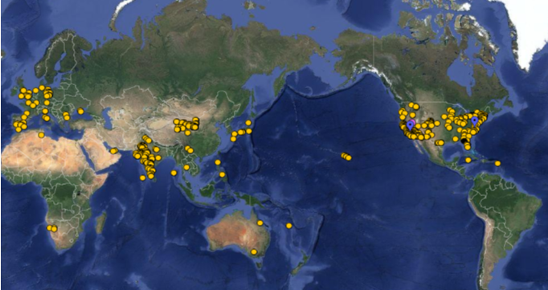
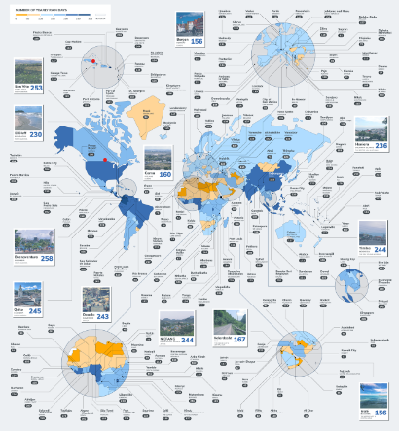
Market Size
LEONARD.EVA@LERTECHX.COM
TAM 7 $620B
SAM $13B
SOM $2.2B
We will initially target the Caribbean and Hawaii, combined market $250M. The hurricanes frequency and severity determine an urgent implementation of this technology.
SOLAR ENERGY MAP & THE RAINFALL PER CITY

Slide 5
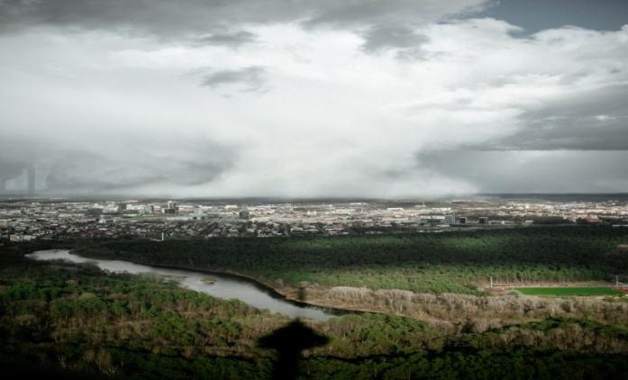
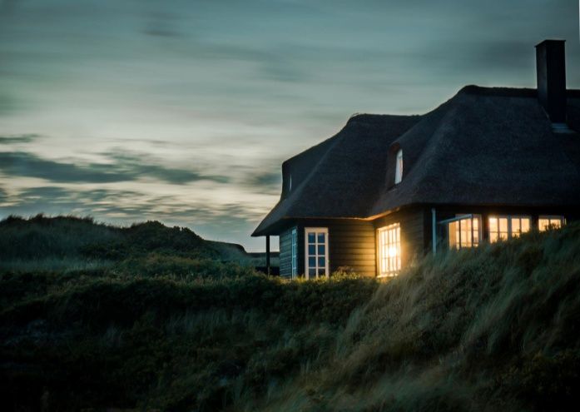
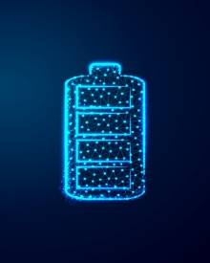
the global Energy transition needs
LEONARD.EVA@LERTECHX.COM
A green technology able to complement and improve the efficiency of the actual intermittent renewable sources.
Sustainable energy storage systems, based on local resources, ready to absorb the surplus of the electricity production.
A good ration Energy Generated/Footprint, that can preserve the natural balance.

Slide 6
Business Model
LEONARD.EVA@LERTECHX.COM
B2B,B2C
Revenue streams :
Sell units to the commercial, residential and industrial customers.
The cost of one unit is $4.5k with the selling price $6k.
The ROI is 6 to 7 years.**
The products’ parts commercialization.
The technology licensing.***
Micro-generation credit.
* Focus on areas where the land availability is a constraint
** The subsidies not included, considering $0.24/kWh
*** IP in US , Canada and UK.

Slide 7
GO TO MARKET STRATEGY
LEONARD.EVA@LERTECHX.COM
Create partnerships with governments’ organisations from Canada, US, EU, Indonesia, Malaysia and Caribbeans.
Develop pilot projects in communities from British Colombia/CA, Dublin/IE than advertise the results in order to expand the areas where the technology can be introduced.
Hire local consultants/advisors/operators to work in regions with urgent need for our solution.
Contact the CEOs from regional Clean Energy Companies and build partnership.

Slide 8
Competition
LEONARD.EVA@LERTECHX.COM
Our game-changing technology it’s comparable to 3 kW Solar/Wind system paired with batteries or the energy storage companies such as Gravity Power.
The competitors’ price range is between $9 to12k.
The technology can generate electricity during rainy/severe weather, day or night.
Resilient, long lasting energy storage unit.
Based on local resources, doesn’t rely on mining and the global supply chain.
Minimum impact on the environment and landscape.
Less footprint, increasing projects accessibility and approval rate.
The technology has a patent in US and is patent pending in CA, UK.

Slide 9
Traction
LEONARD.EVA@LERTECHX.COM
Vancouver area community is interested in a pilot project.
We are in discussions with an important regional player in energy generation and distribution for a partnership.
We received a positive feedback regarding the technology from different industries such as:
Developers QC, US
Vertical Farms BC
Isolated communities BC
Warehouse owners with high operational cost AB, BC

Slide 10
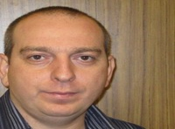
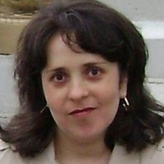
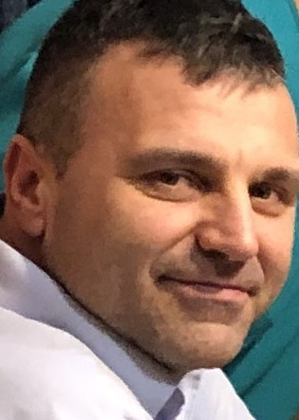
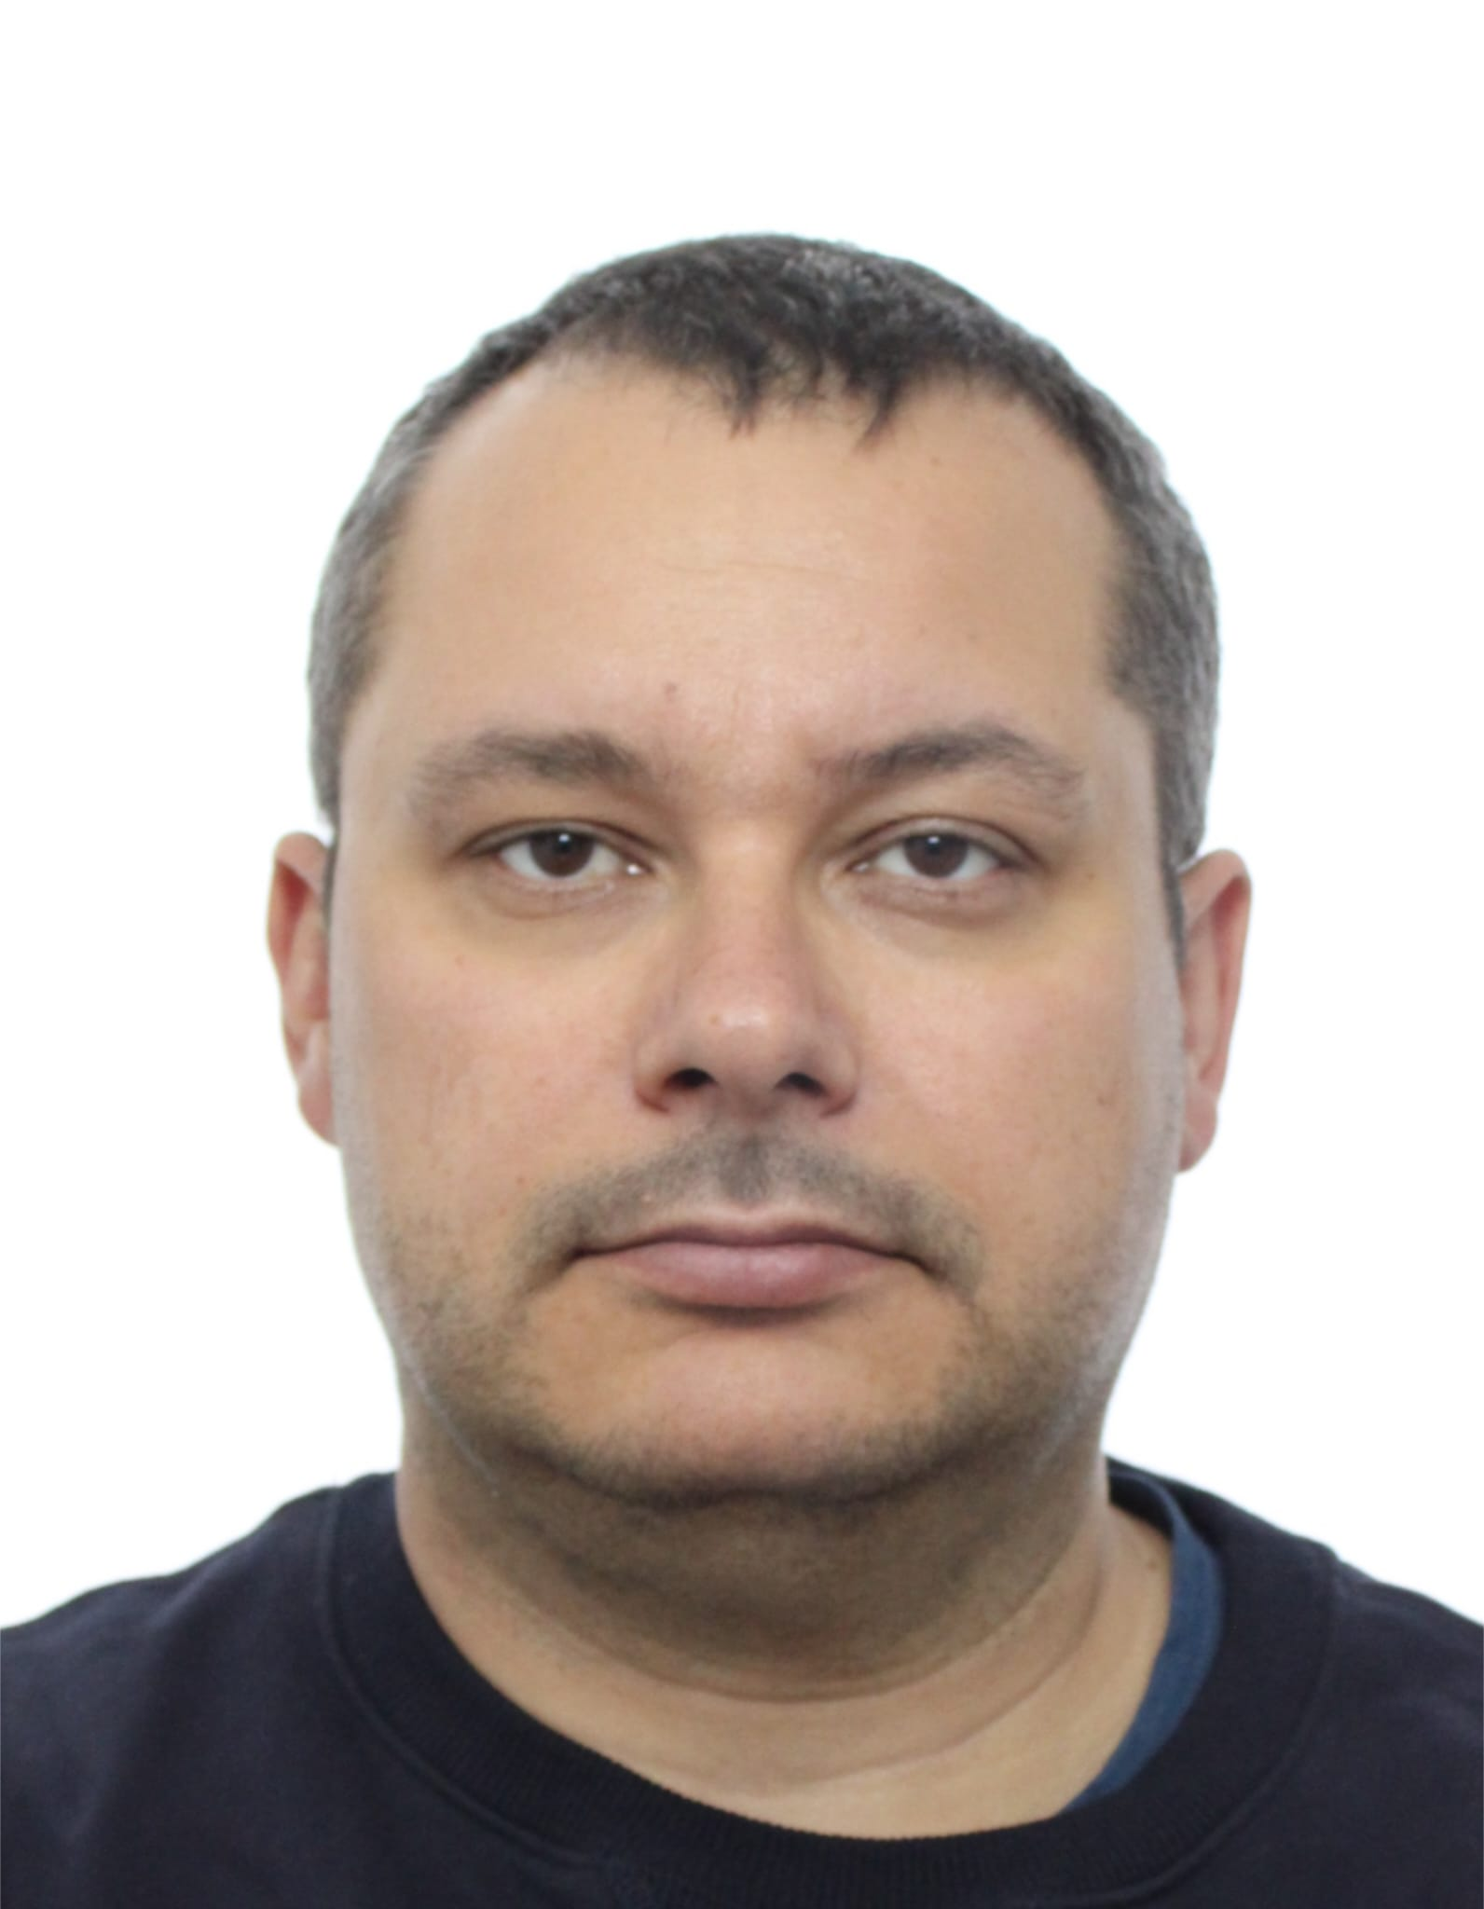
Team
LEONARD.EVA@LERTECHX.COM
Leonard Eva CEO
Industrial Engineer, Human Resources Cert., Six Sigma Green Belt ASQ,
Inventor : US patent granted, Canada and UK patent pending.
Simona Eva COO
Marketing and Business Development
Univ. UTI , B.Scs. Physics-Chemistry
Lana Harper Adviser
Marketing and Business Development
Hanoi University BArch , B.Scs., Emergent Markets Sales Experience
Peter Dabija Adviser
Plumbing and Building Service 20 years experience
Ionut Daila Adviser
Electrical Engineering 15 years experience, Business Informatics Bachelor
Partners; NRC-IRAP Technology Access Center/ Foresight Canada

Slide 11
Financials
Expenses in CAD $ and the roadmap:
$100k Prototype/Team+ IRAP/TAC 12/2024
$250k 5 Pilot Project Team+/Local 12/2025
Revenues:
$32k, SR&ED tax credit 2024-2025
$250k, sales/paid pilot projects 12/2026
$250k, SR&ED,NRC 12/2026
10M sales/multiple streams 12/2029

Slide 12
Fundraising for 24 Months $350k
$100k CAD December 2024
Prototype
Team, Advisors, Business Development
Access to government 50% non-dilutive grants.
Complete one unpaid Pilot Project.
$250k CAD From January to Dec 2025
Team+/Advisors/Improved Prototype R&D
5 paid pilot projects in CA, Caribbean , US, EU
Build a local presence in targeted market.

